Slide 1

Chapter 11 – part I

Slide 2
OUTLINE
  Static and dynamics equilibrium.
  Center of gravity.
  Problems.

Slide 3
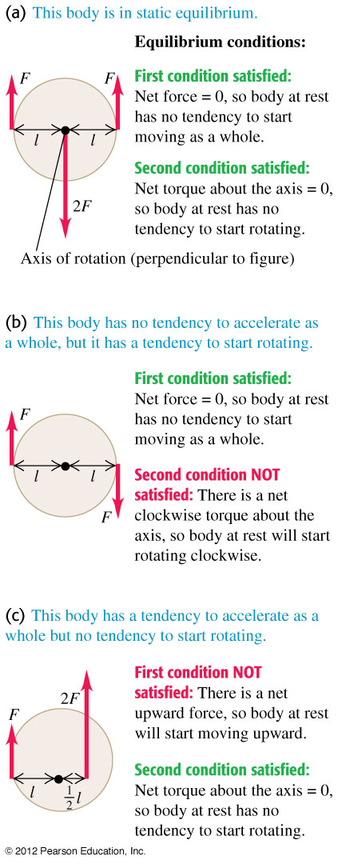
Conditions for equilibrium
First condition: The sum of all the forces is equal to zero:
ΣF_{x} = 0 ΣF_{y} = 0 ΣF_{z} = 0
Second condition: The sum of all torques about any given point is equal to zero.

Slide 4
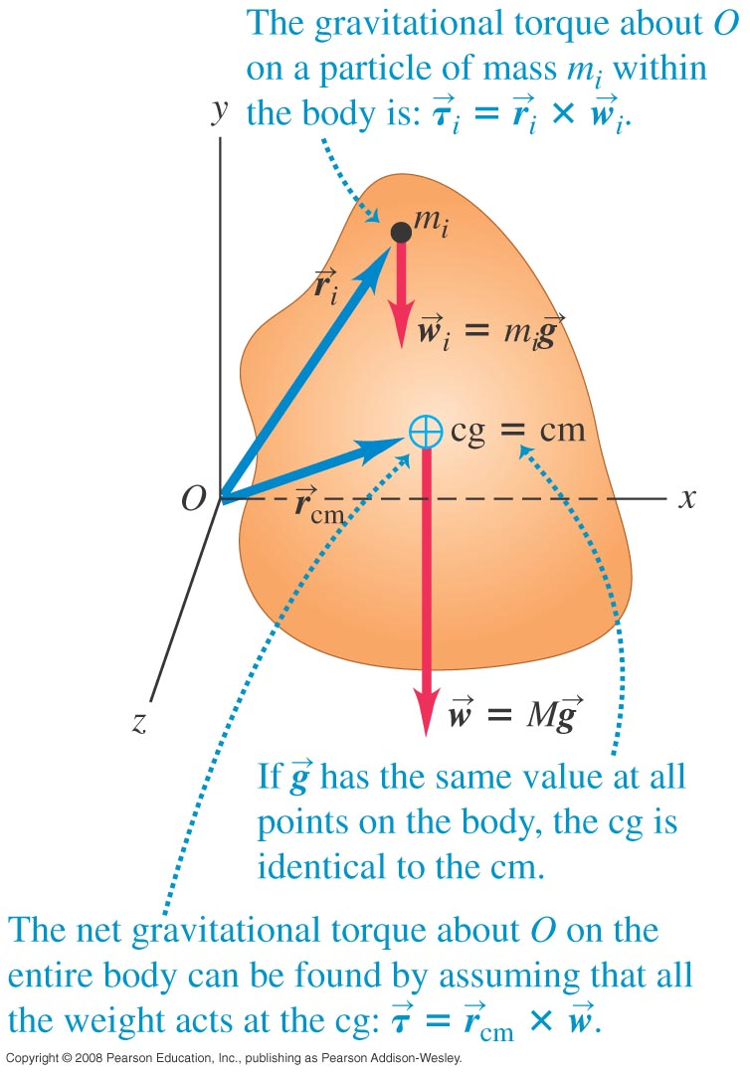
Center of gravity
We can treat a body’s weight as though it all acts at a single point—
the center of gravity.
If we can ignore the variation of gravity with altitude, the center of gravity is the same as the center of mass.

Slide 5
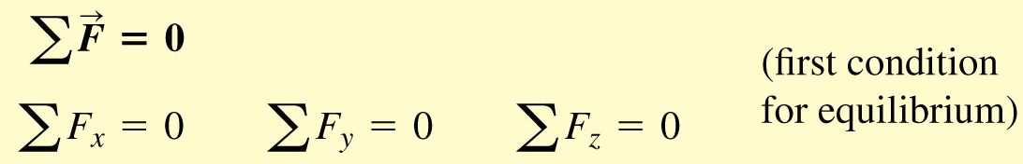
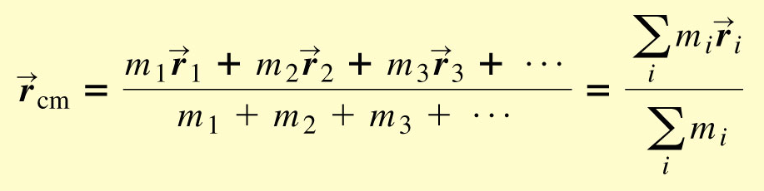
Summary
Equilibrium
Center of gravity

Slide 6
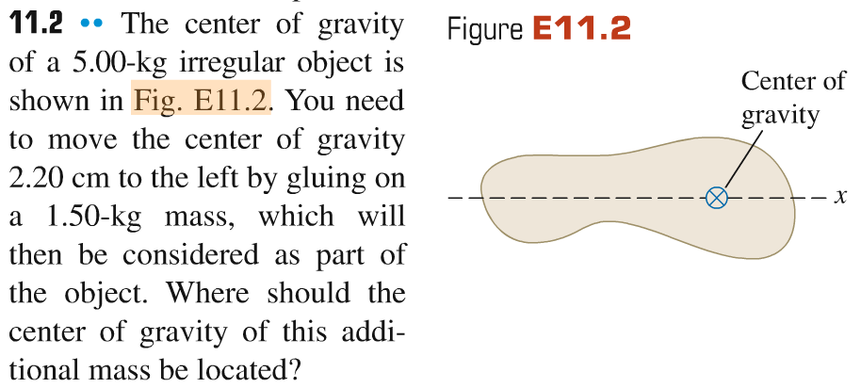
Problem #1

Slide 7
Problem #2
A heavy boy and a lightweight girl are balanced on a massless seesaw. If they both move forward by the same distance L, what will happen to the seesaw? Assume that both people are small enough compared to the length of the seesaw to be thought of as point masses.

Slide 8
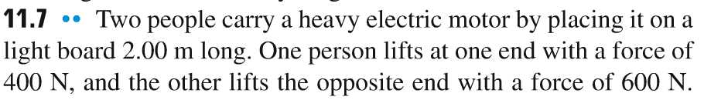
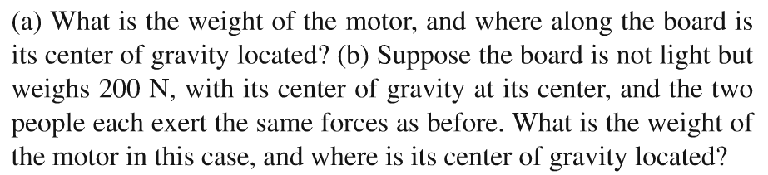
Problem #3

Slide 9
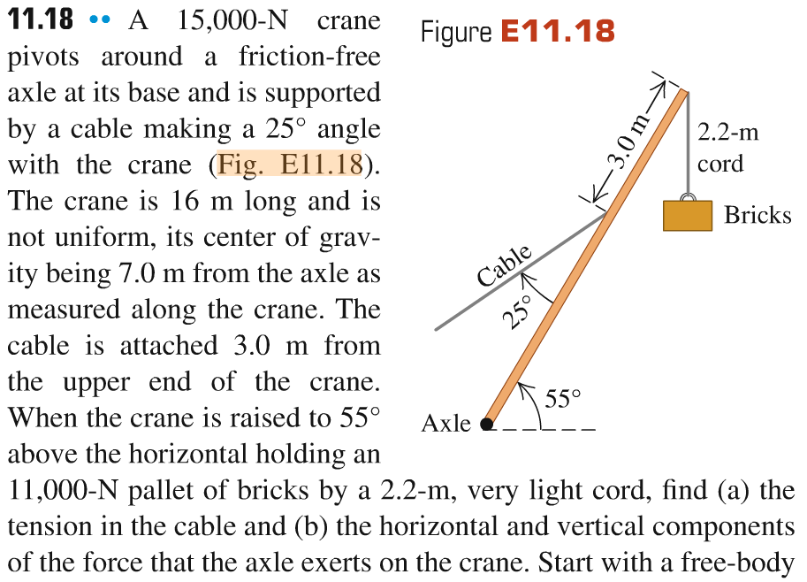
Problem #4

Slide 10
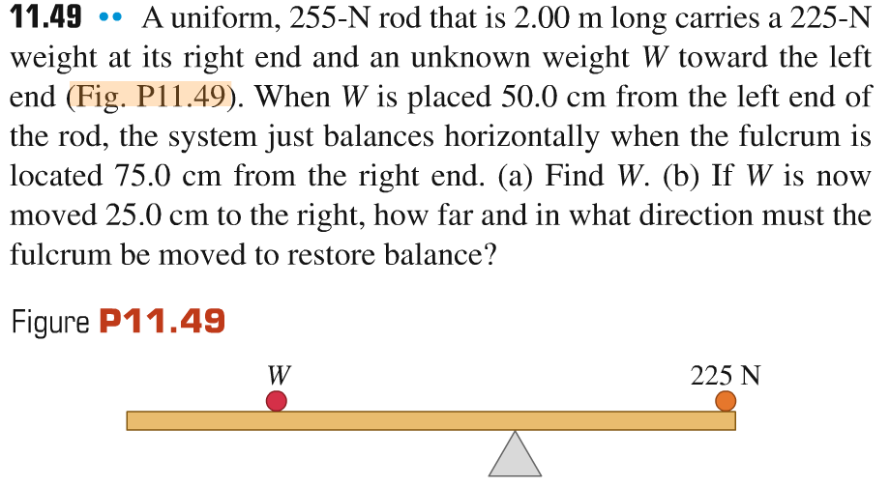
Problem #5

Slide 11
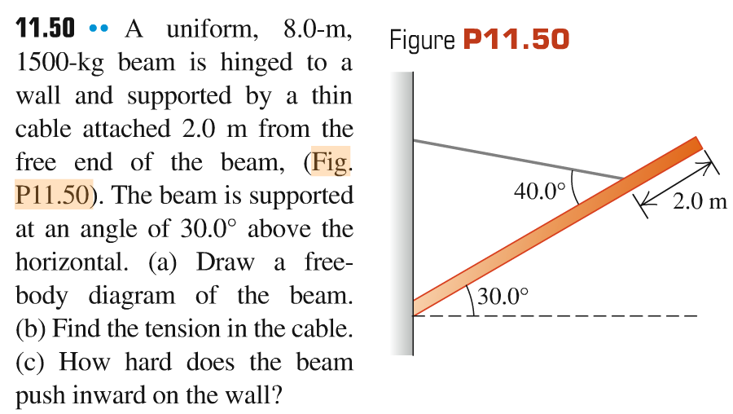
Problem #6

